Slide 1

Exploratory Data Analysis - AMCAT Data Analysis Project

Slide 2
About me
NAME – Janvi Rajendra Charde
Degree – B.TECH (Pursuing)
Programme – Computer science and Engineering (Data Science)
Work Experience :- Fresher

Slide 3
Objective of the Project
Analyze Employment Outcomes:
Investigate salary distributions for roles like Programming Analyst and Software Engineer, validating
claims .
Demographic Influence:
Assess how demographic factors (e.g., gender, college tier) impact employment outcomes and salary
differences.
Skill Assessment:
Examine the relationship between standardized scores in cognitive, technical, and personality skills with job outcomes.
Research Questions:
Confirm the accuracy of salary expectations for fresh graduates.
Explore the relationship between gender and specialization preferences.

Slide 4
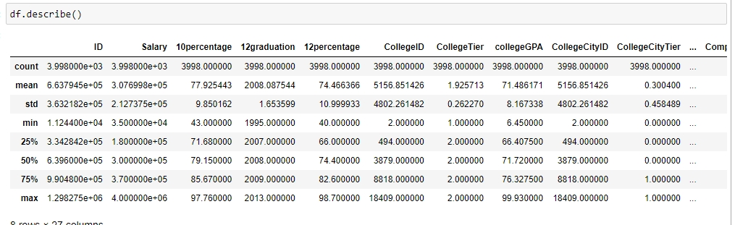
Univariate Analysis Steps
1. Descriptive Statistics:
Generate summary statistics using .describe() for numerical columns.
2. Visualizations:
Create visualizations such as histograms, boxplots, and density plots for numerical variables.
Use countplots for categorical variables to understand distribution.
3. Outlier Detection:
Identify outliers visually and statistically for each numerical column (use boxplots).
4. Observations:
Summarize insights drawn from the analysis of each variable's distribution.

Slide 5
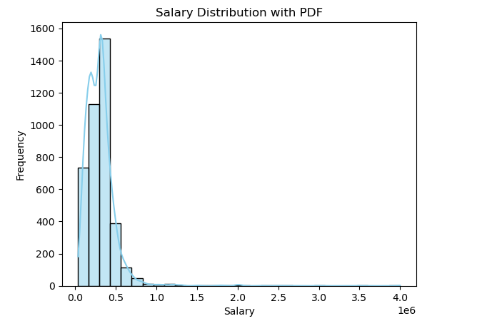
Salary Distribution Analysis
Observations on Salary Distribution
1.Distribution Shape:
The histogram shows a right-skewed distribution, indicating most candidates earn lower salaries, with fewer high earners.
2.Salary Range:
Salaries span a wide range, with many candidates earning towards the lower end and a few at significantly higher levels.
3.Frequency Decline:
There is a notable decline in frequency as salaries increase, supporting the right-skewness.

Slide 6
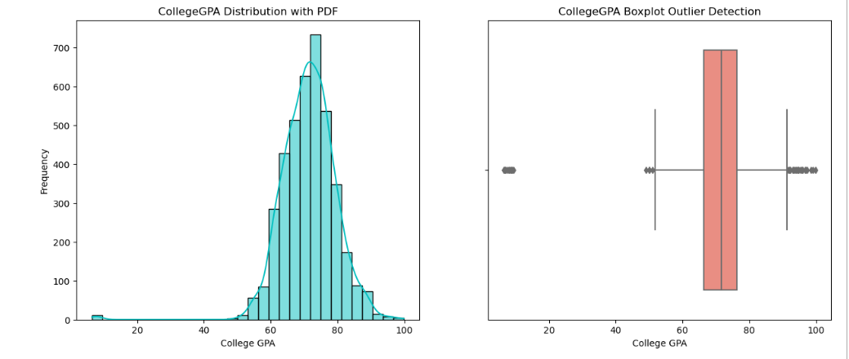
College GPA Distribution Analysis
Observation:-
1. Boxplot for Outlier Detection of GPA
The boxplot shows a tight clustering of GPAs, Indicating similar performance among most candidates.
Several high outliers suggest a small number of candidates achieved exceptionally high GPAs.
2.Histogram with KDE for College GPA
The GPA distribution is roughly normal, peaking
around the average GPA.
Most candidates score in the middle range,
with few at the extremes.

Slide 7
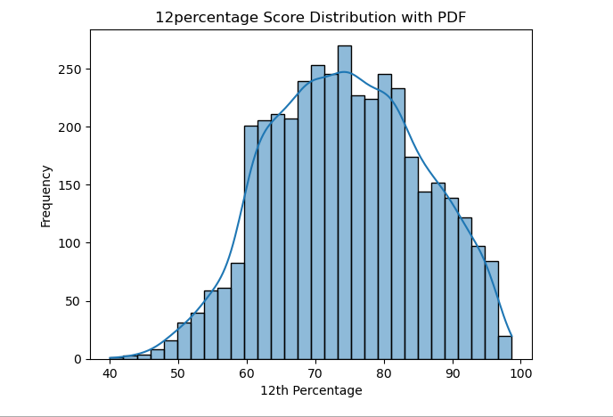
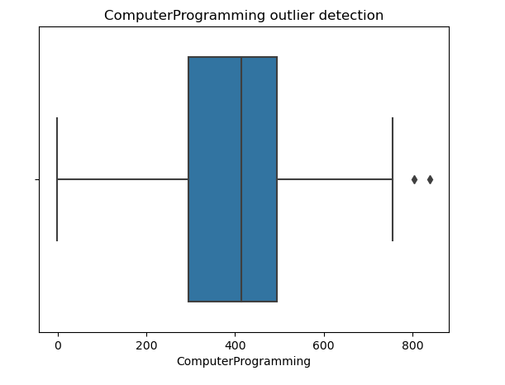
Computer Programming and 12th Percentage Analysis
1. Boxplot for Outlier Detection in Computer Programming
The boxplot indicates that most candidates have scores clustered around the median, with a few outliers on the higher end.
This suggests that while the majority performed similarly, a select few excelled significantly in computer programming.
2. Histogram with KDE for 12th Percentage
The distribution of 12th percentage scores shows a right-skewed pattern, indicating that most candidates scored above average.
There is a clear peak around the higher percentage range, suggesting strong academic performance among graduates.

Slide 8
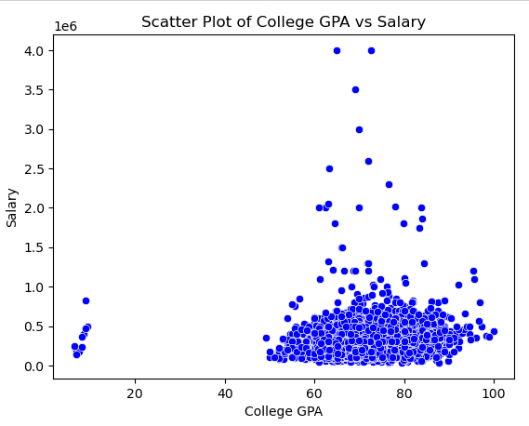
Bivariate Analysis Numerical vs. Numerical Relationships
Scatter Plot of College GPA vs. Salary
Observation:-
The scatter plot reveals a positive correlation between College GPA and Salary, suggesting that higher GPAs are associated with higher salaries.
However, the relationship appears to be weak, indicating that while GPA may influence salary, other factors also play a significant role in determining compensation.

Slide 9
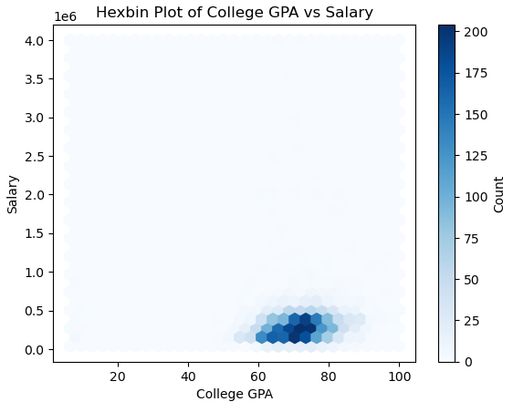
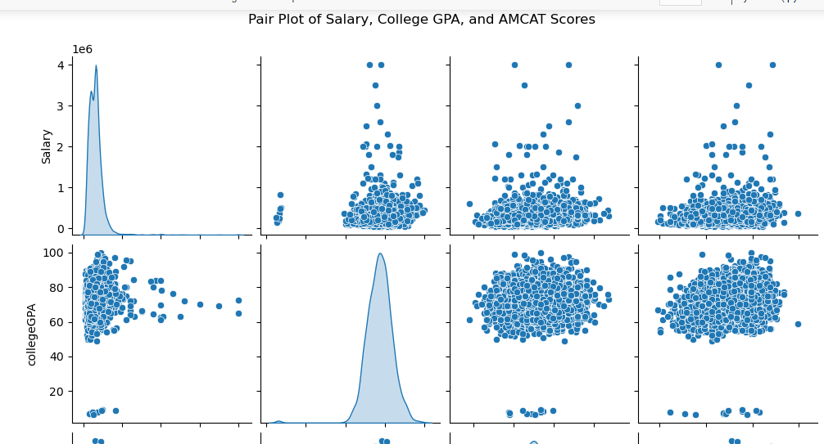
College GPA vs. Salary (Hexbin & Pair Plot)
Hexbin Plot of College GPA vs. Salary: Displays a positive relationship, indicating higher salaries are associated with higher GPAs.
Pair Plot of Salary, College GPA, and AMCAT Scores: Shows strong correlations between College GPA, AMCAT scores, and Salary, suggesting academic performance influences salary potential.

Slide 10
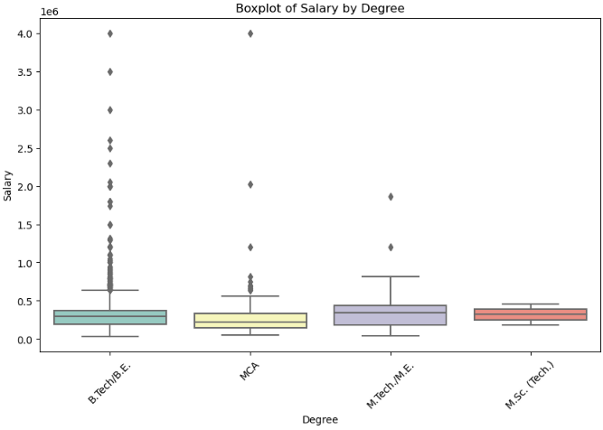
Categorical vs. Numerical Relationships
Salary by Degree (Boxplot)
Observation:
This boxplot reveals clear differences in salary across different degree programs.
Some degrees tend to offer higher median salaries, with significant salary variation within certain degree categories.

Slide 11
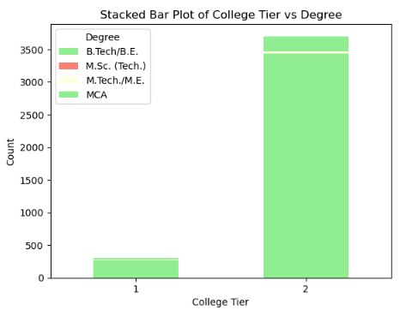
categorical and categorical
Stacked Bar Plot of College Tier vs. Degree
Observation for Stacked Bar Plot of College
Tier vs Degree
Distribution of Degrees: The stacked bar plot displays the number of graduates with different degrees across various college tiers (e.g., Tier 1, Tier 2, Tier 3).
Higher Education Levels: It is evident that Tier 1 colleges tend to produce a larger number of graduates in engineering-related degrees compared to lower-tier colleges.

Slide 12
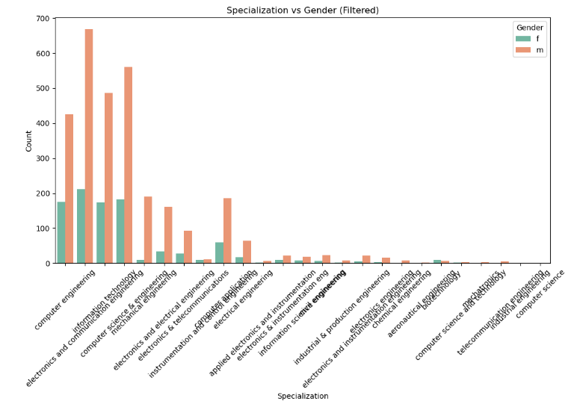
Research Questions
Is there a relationship between Gender and specialization? (i.e. Does the preference of Specialisation depend on the Gender?)
Yes, gender influences specialization choices among engineering graduates. Males tend to favor Mechanical and Computer Science fields, while females lean towards Electronics and Telecommunications.
Observation
Gender preferences in specialization:
Analysis shows distinct specialization choices between genders, with certain fields favored by males and others by females, indicating potential biases in education and career paths.

Slide 13
Conclusion
Academic Performance Correlation: A strong positive correlation exists between college GPA and salary, indicating that higher academic achievements lead to better job offers for engineering graduates.
Specialization Preferences: The choice of specialization significantly impacts employment outcomes, with certain fields offering higher salaries and more prestigious job titles, guiding students in their academic paths.
Gender Disparities: The analysis reveals noticeable gender differences in specialization preferences and salary outcomes, highlighting the need for initiatives to promote gender equity in engineering fields.
Impact of College Tier: Graduates from higher-tier colleges tend to secure better job positions and higher salaries, emphasizing the importance of college reputation in career prospects.
Standardized Skill Scores: High scores in standardized tests (e.g., AMCAT) across cognitive and technical skills are associated with better job placements, indicating their relevance in recruitment processes.

Slide 14
Research Questions
What Factors Influence Salary Differences?: What are the primary factors (e.g., GPA, college tier, specialization) that contribute to the variation in salaries among engineering graduates?
Long-Term Career Success: How do initial job titles and salaries affect long-term career trajectories and job satisfaction in the engineering field?
Gender Diversity Initiatives: What strategies can be implemented to improve gender diversity in underrepresented engineering specializations?
Skills vs. Salary: How do standardized test scores in cognitive, technical, and personality skills correlate with salary and job placement rates?

Slide 15

THANK YOU

